Slide 1
Introduction
Katyani Bajgain
21049520
L3C7

Slide 2

Agenda

Slide 3
This ML project
Model Evaluation and Tuning
Dataset Selection & pre-processing
Model Selection Training
Project Introduction

Slide 4

Why breast Cancer Dataset?

Slide 5
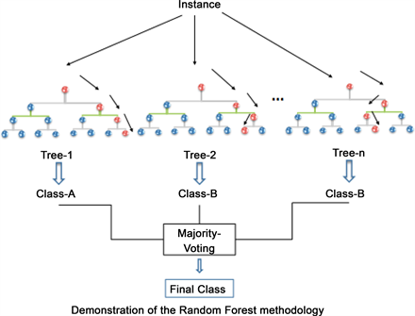
Random Forest Algorithm
Random Forest is an ensemble learning method used for both classification and regression tasks.
It builds multiple decision trees during training and merges their predictions to improve accuracy and control overfitting.

Slide 6
Development PROCESS
Data pre-processing with Train-Test Split
Model Fit
Model Tune
Performance Metrics

Slide 7
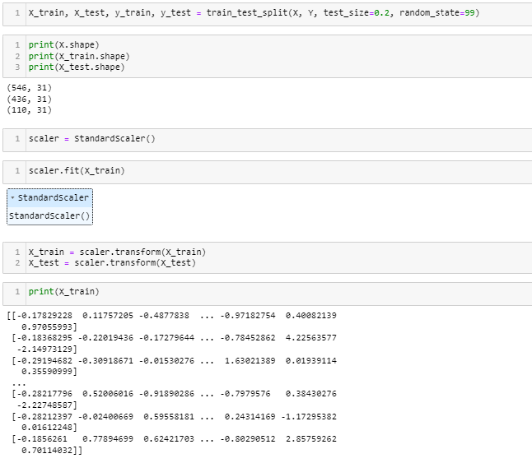
Data Preprocessing Train test Split

Slide 8
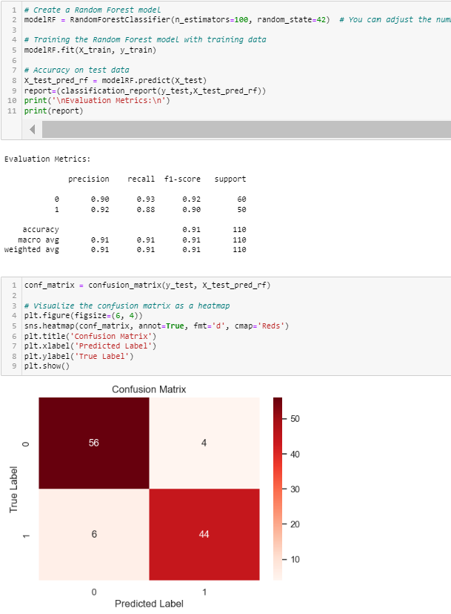
Model Fit

Slide 9
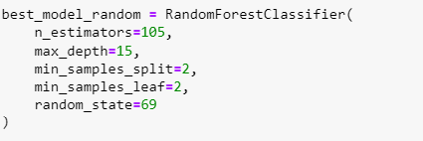
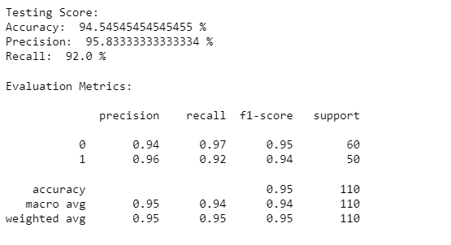
Model Tune

Slide 10
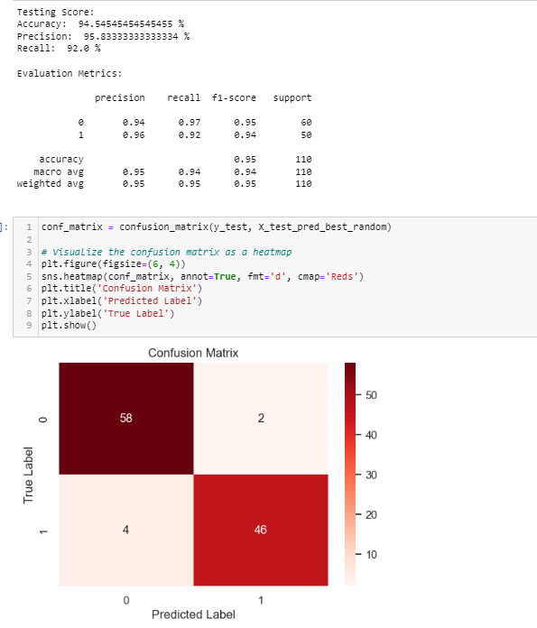
Performance Metric

Slide 11
Conclusion
Approach to machine Learning models
The application of Random Forest algorithm
Training and testing the model using train and test sets
Hyperparameter tuning using RandomSearchCV
Evaluating the performance of he model using metrics such as accuracy, precision, and recall.

